Slide 1


Humic Acid Removal
Investigating how coagulant dosages affect humic acid concentrations in water
More at https://github.com/AguaClara/humic_acid/
Lynn Shin | ms3244@cornell.edu Rachel Lai | rml267@cornell.edu Annie Hsu | yh533@cornell.edu
Dennis Wu | dje323@cornell.edu
Humic Acid Removal | Research | Final Presentation Fall 2021

Slide 2
Table of Contents
Background
Previous Work
Experimental Design
Challenges
Future Work
Humic Acid Removal | Research | Final Presentation Fall 2021
Notes:
Cite your sources here.
Caption your figure and explain its relevance to your presentation/thesis here. You can take the caption from your Final Report and modify it.
Write a summary of this slide here. A future team member or client should be able to read this note and understand this slide without having your team explain it to them.
If there are any appendix slides that are relevant to this slide, mention it in your notes.

Slide 3
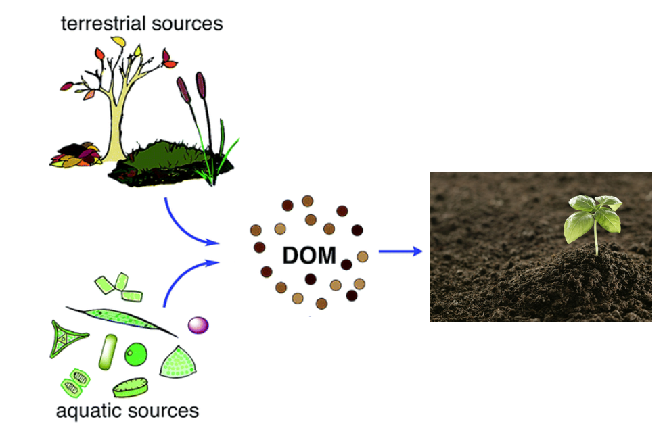
Background
Humic Acid- Dissolved Organic Matter
Creates:
color, taste and odor problems
increased levels of complexed heavy metals and adsorbed organic pollutants
Reacts with chlorine during chlorination - produces harmful byproducts to humans
→ Increased coagulant and disinfectant doses are needed for its removal
Figure 1: Diagram of the formation/ life of dissolved organic material
Humic Acid Removal | Research | Final Presentation Fall 2021
Notes:
Humic acid constitutes a large fraction Dissolved Organic Matter (NOM), which is present in surface and groundwater and results from plant and animal decay. Although it is beneficial to plants because of their stimulation of plant growth and increase of plant disease resistance, it is a deterrent for the drinking water treatment process.
Humic acid has a negative effect on water quality by causing color, taste and odor problems, and increased levels of complex heavy metals and adsorbed organic pollutants. In addition, when humic acid reacts with chlorine, a harmful byproduct chloroform is formed.
Thus, we need a higher dosage of coagulant to removal humic acid, but not too much to prevent flocculation.
image: https://pubs.rsc.org/image/article/2015/EM/c5em90046h/c5em90046h-f1_hi-res.gif

Slide 4
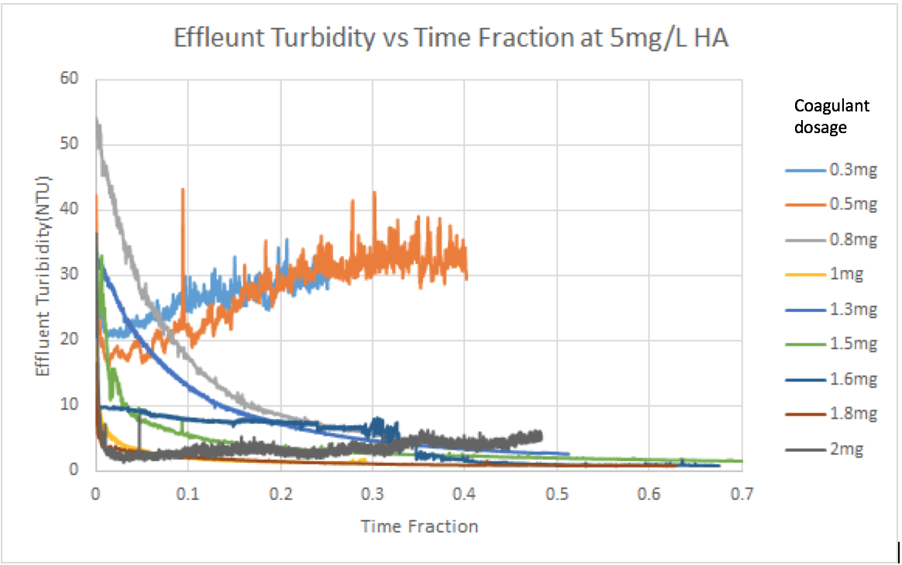
Previous Work
Table I. Humic acid and coagulant concentrations tested in Fall ‘17 and Spring ‘18.
Concentration of Humic Acid (mg/L) | Optimal Coagulant Dosage (mg/L)
5 | 1.6 - 1.8
10 | 1.3
Fall ‘18:
Negative relationship between coagulant dosage and humic acid concentration
Experiments took too long to reach steady state
Figure 2: Absorbance vs. Time Data from Fall ’17/ Spring ‘18 for 5 mg/L of humic acid with various coagulant dosages
Humic Acid Removal | Research | Final Presentation Fall 2021
Notes:
After conducting several experiments with different concentrations of coagulant, the 2017-2018 team discovered the optimal coagulant dosage to be 1.6-1.8 mg/L for water with 5 mg/L of humic acid concentration and 1.3 mg/L for 10 mg/L of humic acid concentration. These results show a negative relationship between coagulant dosage and humic acid concentration, which we would like to verify since other literatures have suggested a positive correlation between the two. The team also tried to come up with a mathematical model to calculate the optimal coagulant dosage with known concentration of Humic Acid but the problem was that even with a large change in concentration, the resulting optimal dosage change is small.
Figure 2: https://lh3.googleusercontent.com/ambz5vswC4PsstALT9CXEqEpDVxyoWzUw-auVQ83mbX-La7uFr5SGkV8-Z03A9fsscCAxKt4gVGXSgUQOpaeZ2JMKmpGQTxxAE2IwKKgmrts10U77Iu_7uQCjYGwlVeBsxGkN49x

Slide 5
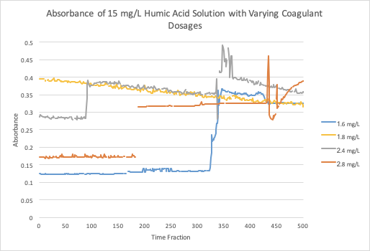
Previous Work
Fall ‘19 and Spring ‘20
Flocs take a long time to form
At higher coagulant dosages around 2-3 mg/L there was very little change of absorbance
Figure 3: Absorbance vs. Time Data from Fall’19 for 15 mg/L at various coagulant dosages
Humic Acid Removal | Research | Final Presentation Fall 2021
Notes:
2 years ago, the focus was on increasing the concentration of humic acid and testing different coagulant dosages at each. The team discovered that at higher coagulant dosages around 2-3 mg/L there was very little change of absorbance recorded which indicates that there’s a limit to how much coagulant can be put in before it becomes ineffective.
Figure 3:
https://github.com/AguaClara/humic_acid/blob/master/Fall%202019/15HA.png

Slide 6
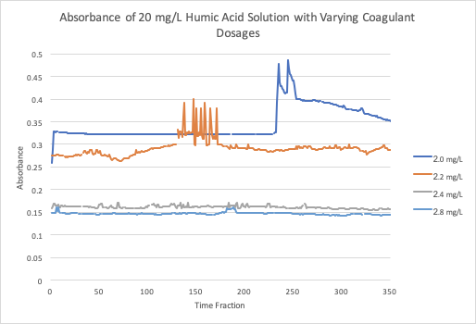
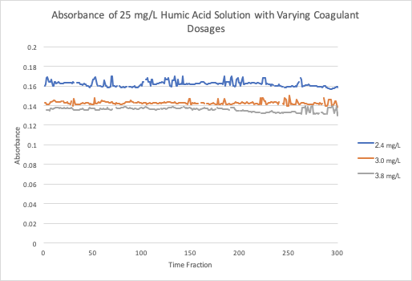
Previous Work
Figure 4: Absorbance vs. Time Data from Fall’19 for 20 mg/L at various coagulant dosages
Figure 5: Absorbance vs. Time Data from Fall’19 for 25 mg/L at various coagulant dosages
Humic Acid Removal | Research | Final Presentation Fall 2021
Notes:
As coagulant doses increase, the absorbance of humic acid decreases. This makes sense because higher concentrations of coagulant can form more flocs in the water and thus decrease the effluent turbidity.
There is a limit to the concentration of coagulant on minimizing the amount of humic acid in water.
Figure 4:https://github.com/AguaClara/humic_acid/blob/master/Fall%202019/20HA.png
Figure 5:https://github.com/AguaClara/humic_acid/blob/master/Fall%202019/25HA.png

Slide 7
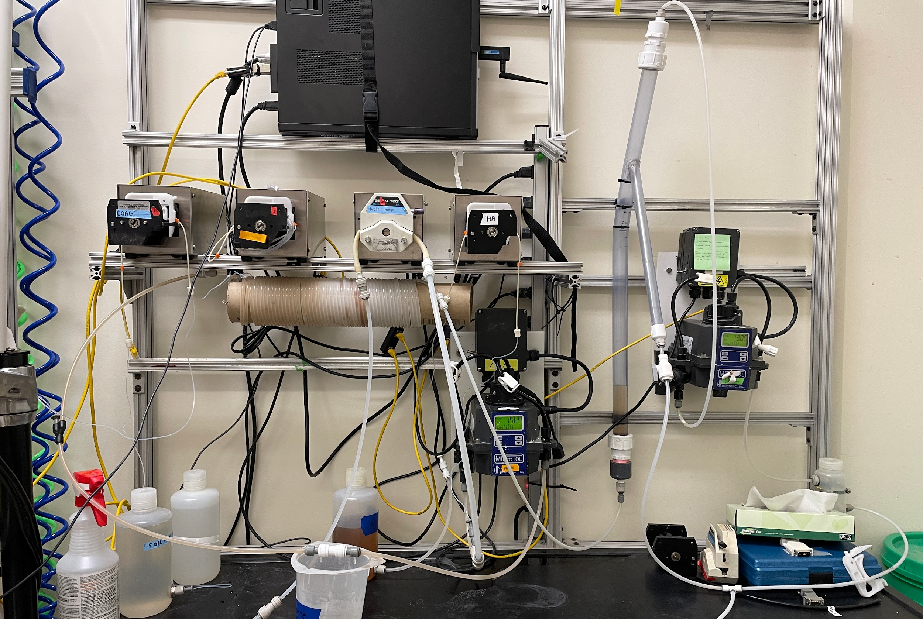
Experimental Design
Water in
Wastewater out
Recirculator
Coagulant pump
Humic acid pump
Water pump
Flocculator
Turbidimeter
Figure 6: Image of lab set-up and experimental design for Fall ’21
Humic Acid Removal | Research | Final Presentation Fall 2021
Notes:
This is our experimental setup for the fall 2021 semester.
Three pumps: one for coagulant, HA, and water
Water is pumped from the inlet and combined with the HA, then goes into the turbidimeter
Then combines with coagulant stream and goes into the flocculator, then into the recirculator and sedimentation tank and then the spectrophotometer
Flocs go into the tube settler, then combine with the stream out of the spectrophotometer to go to the wastewater stream out
Figure 6: picture taken by Annie Hsu on Nov. 22nd 2021. can be found in the humic acid folder in the shared drive

Slide 8
Challenges
Connectivity of the Apparatus
Hardware and Software Issues
Running experiments
Humic Acid Removal | Research | Final Presentation Fall 2021
Notes:
And now, we are going to give a brief overview about what we have accomplished this semester. So far, our team has done literature reviews to gain better understandings of natural organic matter, its effects on drinking water, the relationship between humic acid concentration and coagulant concentration, and how different environmental factors affect this relationship. Also, we have familiarized ourselves with the work done by previous teams and have finished the experimental setup. However, we ran into many issues during this process which included challenges with connectivity of the apparatus, with the hardware and using the software, and with running experiments.

Slide 9
Challenge: Connectivity of
the Apparatus
Leaking issues were fixed by switching out some tubing and connectors
Some of the tubing and wires were not set up correctly
connect the turbidimeter to the COM port
connect the humic acid stream to water stream before entering the influent turbidimeter
Humic Acid Removal | Research | Final Presentation Fall 2021
Notes:
For the past months, we have been constantly fixing and improving our apparatus by fixing leaking and connectivity issues. Many components including tubing and connectors were replaced to stop the leaking. We also realized that some of the tubing and wiring were not set up correctly and we had to connect the turbidimeter to the COM port and connect the humic acid and water streams together before entering the influent turbidimeter.

Slide 10
Challenge: Hardware and Software Issues
Computer was extremely slow
wifi router and more RAM were added
Windows system was updated
Interconnection between the apparatus and ProCoDA
correct COM port and pump IDs were identified
setpoints were created
Humic Acid Removal | Research | Final Presentation Fall 2021
Notes:
We also encountered issues with the hardware of the computer and the software of ProCoDA when we first tried to run preliminary tests. The computer was extremely slow, ProCoDA always took a long time to load, and there was no wifi connection. It was found that we only had 4GB of RAM in our PC, and the system had not been updated since 2019. To resolve these issues, we found and added a wifi router to the PC, updated the Windows system, and added 8GB more RAM to the PC.
After fixing the hardware problems, there was still an issue with controlling the pumps using ProCoDa, so our team did some troubleshooting and finally correctly determined and reset the COM port and pump ID numbers. Setpoints were then created according to the ProCoDA manual.

Slide 11
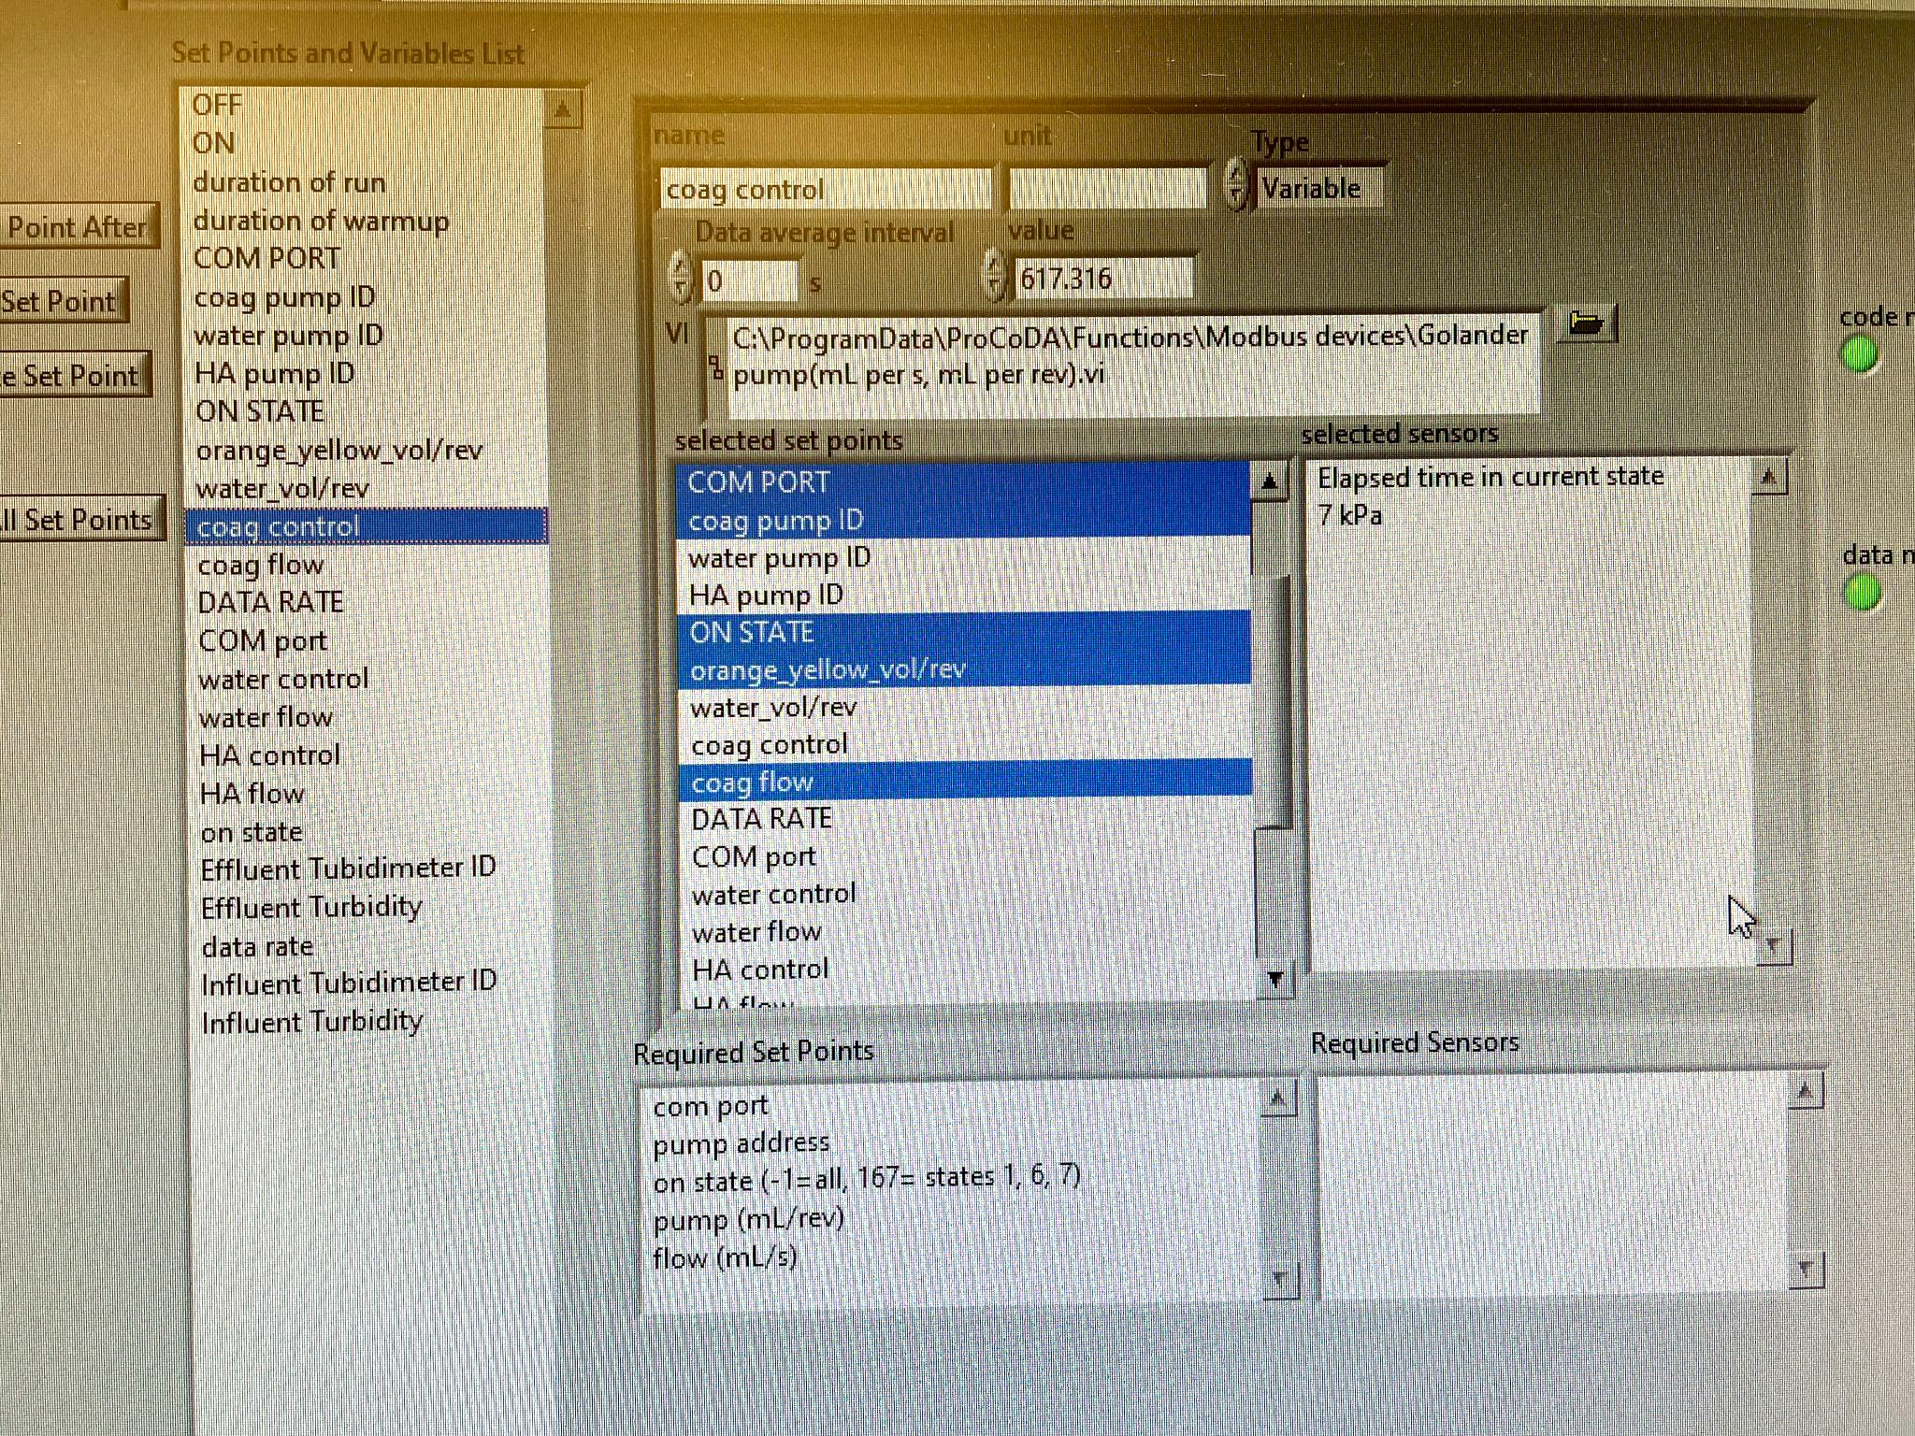
Challenge: Hardware and Software Issues
ProCoDA could not turn on the pumps
the order of the setpoints was found to be crucial and was therefore adjusted
Figure 7: Screenshot of Rule Editor in the ProCoDA file for Fall ‘21 subteam
Humic Acid Removal | Research | Final Presentation Fall 2021
Notes:
However, we found that the pumps still would not run when the operation state was switched to “Run” in ProCoDa. After going through the manual, we noticed that the setpoints required for the controls have to be in the exact same order as pointed out by ProCoDa when setting the “control” setpoints.
On the right is a screenshot of the rule editor of our ProCoDa file, and this is where all the set points are created and modified. On the left hand side of this picture, there are all the set points, and, as their names suggest, the “coagulant control,” “water control,” and “humic acid control” setpoints are the ones that dictate the running of the pumps. It was found that when setting these controls, the required set points have to be in the order prescribed by ProCoDa as shown in the red box. In other words, the com port set point has to be the highest one up on the setpoint list, then the pump address set point, on state, pump volume, and, lastly, the flow rate set point. It is important to note that the green lights on the right would be on even when the setpoints are not in the correct order, so it would be good to check the control set points and the selection and order of the required setpoints if the system is not running properly when it should.

Slide 12
Challenge: Running Experiments
There was no effluent stream coming out of the influent turbidimeter
reconnect the turbidimeter to the COM port
Some of the experiments that ran would take hours to reach the sedimentation tank
Suction is not working properly
causes streams to move upstream instead of downstream and overflow in the sample collecting bottle
Humic Acid Removal | Research | Final Presentation Fall 2021
Notes:
Once our apparatus was mostly completed, we had issues running experiments such as having no stream leaving the influent turbidimeter. We realized that it was not properly connected to the COM port and had to reconnect it. We also noticed that some of our experiments ran for hours from start to finish. However, our experiments ran faster after making some adjustments to the tubing and getting used to running the program many times.
Recently, another issue has been identified, which is that the suction is not working properly. As a result of that, the effluent water that is supposed to leave the system goes upstream and back into the effluent turbidimeter, causing an overflow in our sample collecting bottle. and this dysfunctional suction could also be one of the reasons why the overall flow rate was slow, leading to a prolonged duration for the experiments that we ran earlier.

Slide 13
Future Tasks
1) Vary concentrations of humic acid and concentrations of coagulant to prove a positive relationship among both solutions
2) Define steady state
3) Automate ProCoDA to run for longer periods of time
Humic Acid Removal | Research | Final Presentation Fall 2021
Notes:
Now that we have finished our experimental setup, our goals for next semester are to validate a positive relationship between humic acid concentrations and coagulant dosage by varying the concentrations of both humic acid and coagulant. We will also be working towards defining a steady state, which has not yet been determined by the previous teams, so we can get a sense of when the measurements can be taken to be able to get reliable and contributive data that would allow us to interpret the results, find the correlation, and redesign our experiment more easily. Another goal that we would like to achieve is to design an automated ProCoda code that would allow experiments to run for longer periods of time without us being present in the lab to start and stop the experiments.

Slide 14
Questions
and
Recommendations
Lynn Shin | ms3244@cornell.edu
Rachel Lai | rml267@cornell.edu
Annie Hsu | yh533@cornell.edu
Dennis Wu | djw323@cornell.edu
Humic Acid Removal | Research | Final Presentation Fall 2021
Notes:
Lynn Shin | ms3244@cornell.edu Rachel Lai | rml267@cornell.edu Annie Hsu | yh533@cornell.edu

Slide 15
Bibliography
Logan, B. E., Hermanowicz, S. W., & Parker, A. S. (1987). A Fundamental Model for Trickling Filter Process Design. Journal (Water Pollution Control Federation), 59(12), 1029–1042.
Matilaninen, A, Vepsalainen, M & Sillanpaa, M. (2010). Natural Organic Matter Removal by Coagulation during Drinking Water Treatment. Adv Colloid Interface Sci.
Soh, YC, Roddick, F & Van Leeuwen, J. (2008). The Impact of Alum Coagulation on the Character, Biodegradability and Disinfection By-product Formation Potential of Reservoir Natural Organic Matter (NOM) Fractions. Water Sci Technol. 58(6), 1173-9.
Kopfler, F., H. Ringhand, W. Coleman, AND J. Meier. REACTIONS OF CHLORINE IN DRINKING WATER, WITH HUMIC ACIDS AND 'IN VIVO'. U.S. Environmental Protection Agency, Washington, D.C., EPA/600/D-84/196 (NTIS PB85160737).
Du, Y. (2017). Observations and a Geometric Explanation of the Effects of Humic Acid on Flocculation.
Humic Acid Removal | Research | Final Presentation Fall 2021
Notes:
-Carolyn

Slide 16
Appendix
Slides
Humic Acid Removal | Research | Final Presentation Fall 2021
Notes:
This semester, the Humic Acid Removal subteam began work in the lab by familiarizing ourselves with equipment and past work done by previous teams. Moving forward, we are working towards validating the relationship between optimal coagulant dosage and humic acid concentration in order to effectively remove the humic acid from the water in substandard conditions. The team has set up a system in which the effectiveness of the coagulant dosage is evaluated by pumping water, humic acid, and coagulant through an influent turbidimeter, a flocculator, a recirculator, a spectrophotometer, and an effluent turbidimeter.

Slide 17
Background
Natural Organic Matter: Present in surface and groundwater
Humic Acid
1) Color, taste and odor problems
2) Increased coagulant and disinfectant doses needed for removal
3) Biological growth in distribution system
4) Increased levels of complexed heavy metals and adsorbed organic pollutants
5) Increased levels due to climate change and human activity
Reacts with chlorine during chlorination - harmful effects
Figure 1: Diagram of the formation/ life of dissolved organic material
Humic Acid Removal | Research | Final Presentation Fall 2021
Notes:
-Maya
Natural Organic Matter (NOM): Present in surface and groundwater. Within Natural Organic Matter, Dissolved Organic Matter (DOM) is a part of NOM that results from plant and animal decay. Humic acid constitutes a large fraction of DOM. and although they are beneficial to plants because of their stimulation of plant growth and increase of plant disease resistance, they are not beneficial for the drinking water treatment process.
Humic acid has a negative effect on water quality by causing colour, taste and odor problems, increased coagulant and disinfectant doses needed for removal (which in turn results in increased sludge volumes and production of harmful disinfection by-products), biological growth in distribution system, and increased levels of complexed heavy metals and adsorbed organic pollutants.
react with the chlorine to produce trihalomethanes and haloacetic acids, which have carcinogenic effects

Slide 18
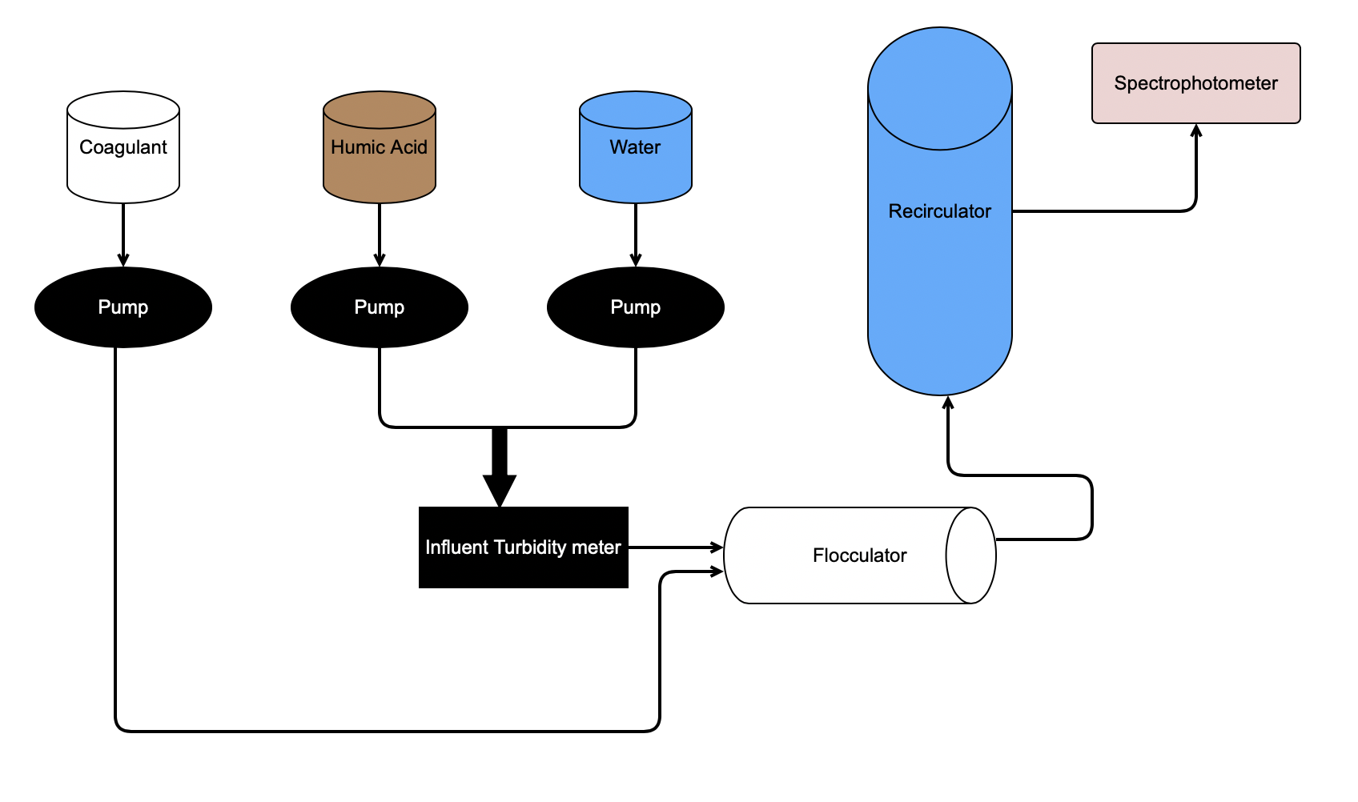
Schematic Drawing
Effluent Turbidimeter
Figure 2: Schematic drawing of the experimental set up for testing varying humic acid and coagulant concentrations
Humic Acid Removal | Research | Final Presentation Fall 2021
Notes:
Brief schematic drawing of process/show general flow of solutions”
Water and humic acid are pumped in and combined before entering the influent turbidimeter. Coagulant is added to the humic acid - water solution and enters the flocculator where flocs form. It then moves into the recirculator where the flocs settle in the sedimentation tank. The wastewater travels out from the recirculator and the clear water rises to the top. Then this goes through the spectrophotometer and effluent turbidimeter to measure the absorbance and turbidity of the effluent water.
Schematic image:
https://raw.githubusercontent.com/AguaClara/humic_acid/master/Fall%202018/Setup.jpg

Slide 19
Experimental Design
Water in
Wastewater out
Recirculator
Coagulant pump
Humic acid pump
Water pump
Flocculator
Turbidimeter
Figure 3: Image of lab set-up and experimental design for Fall ’21
Humic Acid Removal | Research | Final Presentation Fall 2021
Notes:
This is our apparatus for fall 2021
Three pumps: one for coagulant, HA, and water
Water is pumped from the inlet and combined with the HA, then goes into the turbidimeter
Then combines with coagulant stream and goes into the flocculator, then into the recirculator and sedimentation tank and then the spectrophotometer
Flocs go into the tube settler, then combine with the stream out of the spectrophotometer to go to the wastewater stream out
Figure 3: picture taken by Annie Hsu on Nov. 22nd 2021

